Slide 1
HITCH HIKER’S GUIDE TO THE US VISAS
A FOREIGN forensic pathologist tale

Slide 2
Contents
About me
Visas and transitions
Areas of potential improvements
Education and employment through Canada, Grenada and the United States
B1 visas (visitor)
J1 visas (training)
J1 waiver and the Conrad-30 program
H1b visas on return of service
H1b visa transfers on return of service
H1b portability act (post return of service life)
Green card sponsorship
Where to apply?
60-day grace period between jobs
Burdens of this pathway
Physician immigration blog
Questions for the group

Slide 3
About me
By Darwinek, CC BY-SA 3.0, https://commons.wikimedia.org/w/index.php?curid=7021554
By Svgalbertian - Own workThis vector image includes elements that have been taken or adapted from this file: Flag of Wisconsin.svg., Public Domain, https://commons.wikimedia.org/w/index.php?curid=6911071

Slide 4
About me
Education
Undergraduate education:
University of Western Ontario, Canada
Bachelor of Science: Biology
Medical School:
St. George’s University, Grenada West Indies
Medical Doctor Degree
Rotations in New Jersey and New York (B1 visa)
Residency (J1 visa):
St. Barnabas Medical Center, Livingston, New Jersey
Anatomic pathology boarded
Fellowship (J1 visa):
San Diego County Medical Examiner’s Office
Forensic pathology boarded

Slide 5
Employment
Dane County Medical Examiner’s Office, Madison, Wisconsin (J1 waiver to H1b visa on ROS)
Deputy Medical Examiner
Office of the Chief State Medical Examiner’s Office, Newark, New Jersey (H1b transfer on ROS)
Associate Medical Examiner
Middlesex County Medical Examiner’s Office, North Brunswick, New Jersey (H1b transfer post ROS)
Employment begins July 6, 2021
ROS= Return of service (3-year commitment)

Slide 6
Visas and transitions
From the experience of a Forensic Pathologist

Slide 7
Definitions and practical applications
B1 visa
J1 visa
J1 visa continued
Visitors to the United States
Also known as a tourist visa
Apply through consulate
Acquired at Pearson Airport flying to USA
Provided documentation from St. George’s University
Clinical rotations
No ability to work/have a wage while staying
6 months to a year issuance
Training visa during residency and fellowship
Making a salary
Available for 7 years (extensions possible)
Can be extended to stay to write board examinations
Personally used 5 years out of the offered 7
Funded by the applicant
Easy to establish through employment
Sponsored by the Education Commission for Foreign Medical Graduates
The deal:
Train for up to 7 years
Return to home country for 2 years (home residency requirement section 212)
Country dependent
OR
Three years in an UNDERSERVED area of the United States (CONRAD 30 program)
Waived “home residency requirement”

Slide 8
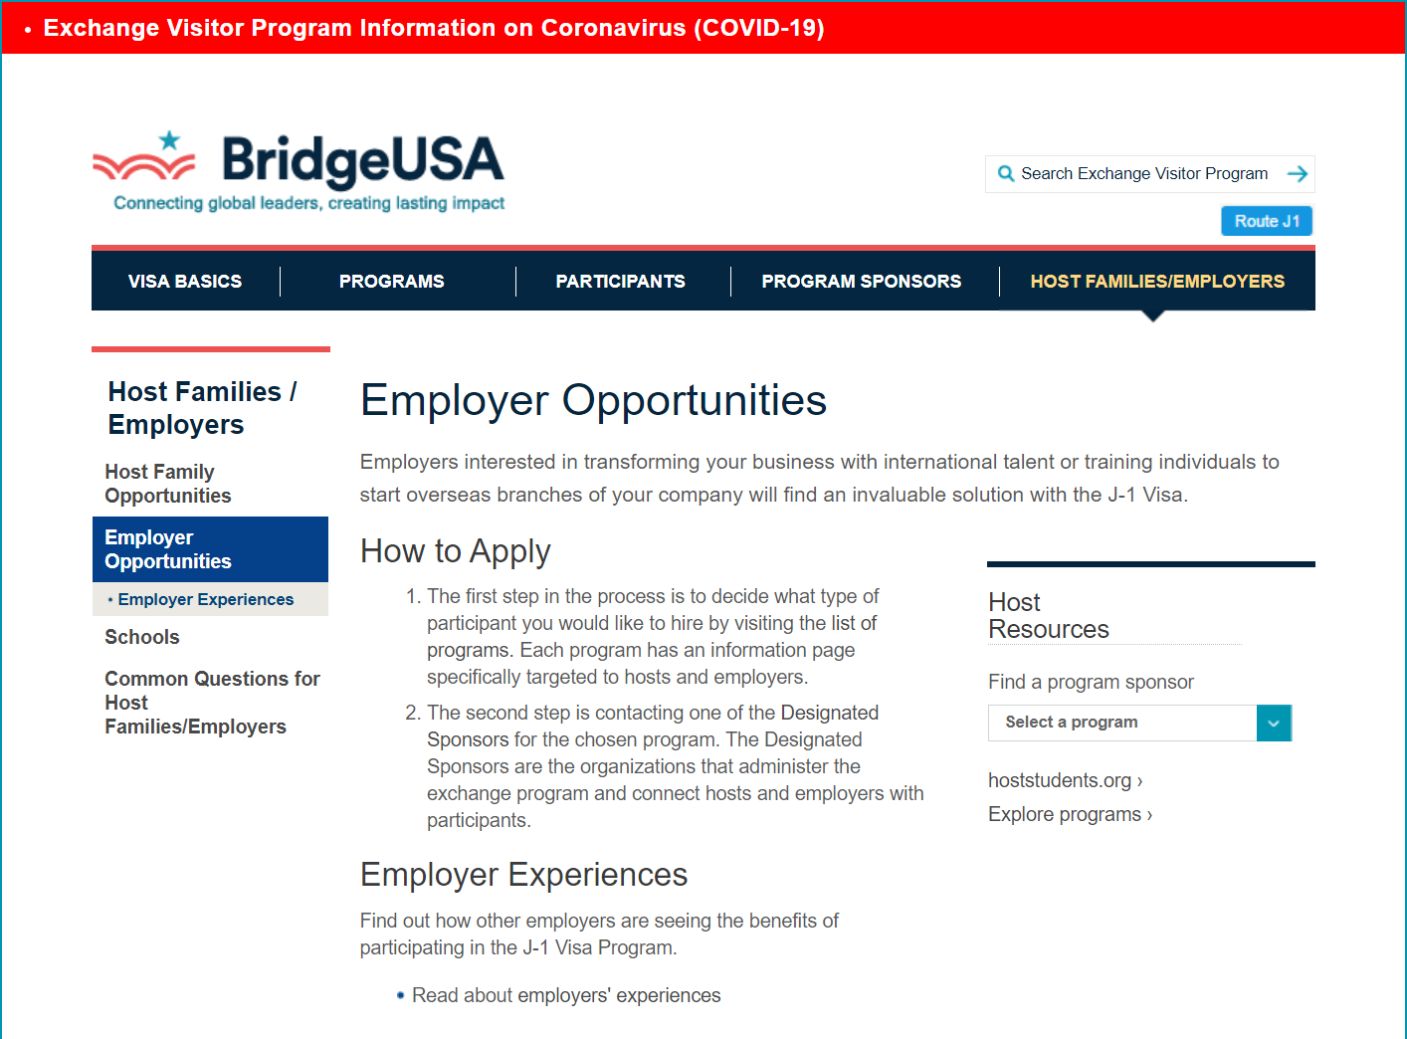
Hiring a fellow and they are on a J1 visa?
You want to become a “sponsor”
St. Barnabas and San Diego was not a J1 sponsor while training, had to establish this
Start here →
https://j1visa.state.gov/hosts-and-employers/employers/

Slide 9
Definitions and practical applications
4 ways to waive a home residency requirement
FEAR OF PERSECUTION
EXCEPTIONAL HARDSHIP TO US CITIZEN OR LAWFUL PERMANENT RESIDENT
REQUEST BY STATE HEALTH DEPARTMENT
Conrad 30 program
I used this route
INTERESTED FEDERAL AGENCY:
Appalachian Regional Commission
Delta Regional Authority
Department of Veterans Affairs
Department of Health and Human Services

Slide 10
Definitions and practical applications
Conrad 30/J1 waiver
Conrad 30/J1 waiver cont..
J1 waiver application
Conrad 30 program:
30 waivers per state for PRIMARY CARE in underserved areas
Up to 10 waivers allocated to specialties
States can choose to allocate 0 slots to specialties
DIRECT PATIENT CARE
MUA= Medically underserved areas defined by zip code
Found through 3Rnet.com via an address search to see if office/ hospital qualifies as “Medically underserved”
Can circumvent zip code with medically underserved specialty (all ME offices technically serve the underserved)
First Monday of every October (annual application)
First come, first serve basis
Need to have a job already lined up shortly after beginning fellowship to allow time for paperwork and filing that October (3 months into fellowship)

Slide 11
Limiting factors
Who offers these positions?
So far only a few states offer Forensic waivers:
Wisconsin
Virginia
Washington State (no longer)
Maryland
Montana?
Georgia (new!)
Michigan
North Dakota?
New Jersey
WHERE DO WE START?
Just because a state offers the ability for a forensic pathologist to waive, does not mean an office is willing to do the waiver due to budget limitations, lack of lawyers or staff to be able to coordinate the process.
Just because a state offers a waiver, does not mean that situation will remain the same forever
Washington state used to offer J1 waivers but for unknown reasons, no longer does
Adds to the confusion and research needed by the applicant to seek out employment

Slide 12
Limiting factors
Lack of education
Finances
Finances
For both employer and employee
Creates a time gap to learn
Can be months worth of time
Amenable by a private immigration attorney to educate both parties
Upwards of $10,000 for sponsoring office
H1b visa cannot be funded by the applicant and must be provided by the sponsoring agency
Lawyer fees/government fees/expedited fees/J1 waiver fee
Up to $10,000 for an applicant with $300-500 thousand in debt
Entire process from H1b to Green card (next phase) is upwards of $40,000 if sponsoring agency is WILLING to sponsor a green card
H1b visas are good for 6 years
Must go home if you cannot get a green card

Slide 14
Three-year commitment “Can be great, can be hang yourself in the closet moment”
H1b visa abuse
H1b visa transfer
Well known amongst the community of immigrants that you will be “taken advantage of”
Personal experience in this matter
Lack of ability to chose best fit job situation due to minimal choices and desperation
Choice of unemployment vs career progression with/without debt is not actually a choice
Can transfer to another medically underserved area.
Must be governed by an underserved zip code
Only one chance to do this
Minimal options and no resources to find out where to apply
Costly to applicant and employer (up to $9,000) combined
60 days to find a job (resignation or termination situation)

Slide 15
Beyond the three-year return of service
Staying in the same place
Moving on: H1b Portability act
Green card pathways
Once the return of service commitment is complete, the applicant can chose to stay or to leave
Employer must apply for another 3 years (H1b visa extension) to keep the applicant
Discussion of progress from there (applicant decides to go to home country or apply for green card through different methods
Finding a place that is willing to sponsor yet again!
Process can take months
Same costs as before to employer and employee (~$9,000 combined)
Few options available (not all included):
Employment categories (EB-1 through EB-5)
18-24 months
Marriage to US Citizen
6-9 months
National Interest Waiver
Research based but due to opioid crisis can be considered

Slide 16
Areas of Improvement
It is all about efficiency and organization

Slide 17
Where to start?
If applying for a job, you already know your skill set and type of job you want →Forensic pathology
Who offers those jobs?
National Association of Medical Examiners (NAME) job board
Who sponsors an H1b visa?
?????
Shot gun email method to every job opening
Immigration attorney of some use for historical CONRAD 30 waivers for Forensics
Applicant generally on their own without a resource
VISA APPLICANT ADVISORY COMMITTEE (VAAC)
Committee through NAME
In early infancy stage to help tackle this issue
Find out which offices can sponsor visas (training or employment)

Slide 18
H1b transfer during ROS and H1b portability act
Same concept as where to start and where to restart for sponsorship
Much easier to transfer H1b than it is to find a J1 waiver state as the J1 waiver has already been established in the original state
Only 60 days to educate the new sponsor and get paperwork in order and filed
Process takes about 5-6 months to complete a transfer
60 days elapse and applicant must leave country
Financial hit both for employment/retirement potential

Slide 19
BURDENS
Financial and time
Relationships
Mental health
So far spent approximately $50,000+ of personal expenses (1 year of residency training)
Moving (2007-2021 moved 10 times with no moving stipend)
Storage
Lawyer and government fees
Deferred retirement savings for 5 years
Lost wages (unemployed for 10 months total in 4 years)
Currently married in a 5.5-year relationship and have not been able to live with spouse
Living separately =$$$$
Friendship and family neglect
Frequent moves do not allow for development outside of the workplace
Lack of choice means potential for toxic work environment/isolation and depression
Chronic understaffing leads to opportunity for employers to abuse applicants
Stakes very high for applicant
Minimal choices to transfer
Expensive to move and be unemployed

Slide 20
Education and Change
www.thephysicianimmigrant.com
Navigation bar:
Blog
Start here
Gives more detailed information about the visas and steps
Creation of a blog:
Education and understanding immigration from a physician perspective
Understanding of sacrifices required before embarking on this journey

Slide 21
National Association of Medical Examiner’s Presentation
https://www.thename.org/assets/2018Handouts/6.3%20-%20Rajkumar%2C%20Anita.pdf

Slide 22
Questions for the group
Is there a way for ALL states to recognize forensic pathology as “direct patient care?”
Why does the J1 waiver to H1b application have to be an annual event?
Is there a way to offer a grant for offices to be more willing to accept sponsorship?
Is there a physician immigration lawyer group to handle the communication/ paperwork between applicant and office?

